Slide 1
Epidemic trends of COVID-19 in Bangladesh

Slide 2
Key messages
Why does the epidemic look like this?
Delta began to emerge in Bangladesh months ago, spreading West-East from India border
We responded too late (like for Beta variant from South Africa)
The resurgence is not one wave, but compounded epidemic growth
When will this get better?
How long will it go on on for? And how much worse will it get?
Delta transmission rate faster than original variant (similar or less than Beta)
Disease severity & case fatality higher
Urban areas will have more extended epidemics due to:
More imports seeding spread
Larger populations maintaining infection
Rural cases seeking care in urban health facilities
What needs to be done for the future?
Masks can STILL slow growth now - Mask messaging is CRUCIAL - outbreak will likely go on for months
Preparation for inevitable new variants.... Lambda
Need to take action now
Vaccine rollout
Build preparedness capacity & communications

Slide 3
How is this surge different from the previous ones?
This is the Delta variant (B.1.617.2 lineage) = “most able, fastest, and fittest”*
Contains multiple fitness-enhancing mutations in the spike protein, in the N-terminal domain, receptor binding domain, and the furin cleavage site of the spike protein
Completely escapes neutralization (blocking) by some the monoclonal antibodies targeting the spike protein and demonstrates 2-fold titre reduction against antibodies to the wild-type (original) strain
Approximate 60% faster rate of transmission with 2-fold higher risk of hospitalization than the Alpha (UK) variant
Nearly completely escapes antibodies from one dose of AstraZeneca vaccine
Clinicians report a faster clinical progression with Delta compared to the wild-type
Current data does not support that previous infection with Beta variant will provide better immunity against Delta variant than immunity from the previously circulating variants
Delta was most likely was introduced via land border in Rajshahi, not via the airport in Dhaka
Took longer to reach Dhaka
Surge as a whole stretches over a longer period of time
* Dr. Mike Ryan, WHO global COVID-19 press conference, 22 June 2021

Slide 4
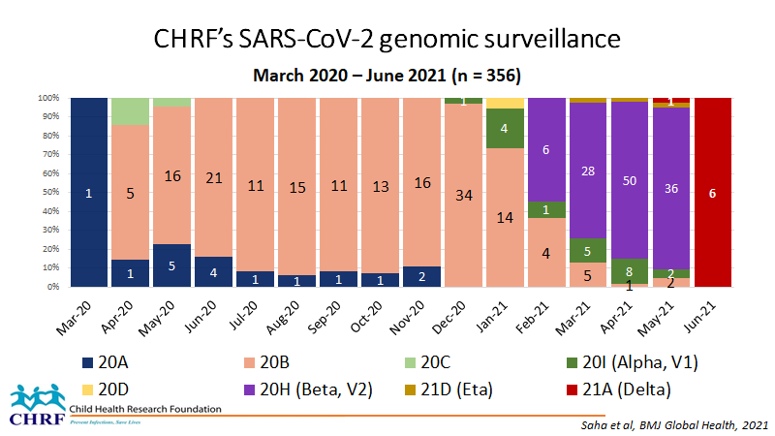

Slide 5
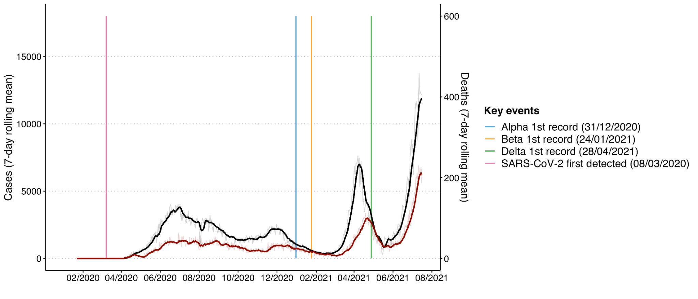
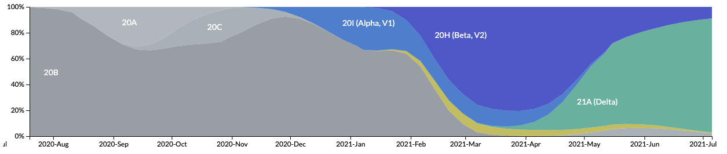
Each epidemic wave in Bangladesh has been driven by new variants
Beta - faster transmission
& more severe
Delta - similar transmission & even more severe
Original variant - slower transmission & less severe than later variants

Slide 6
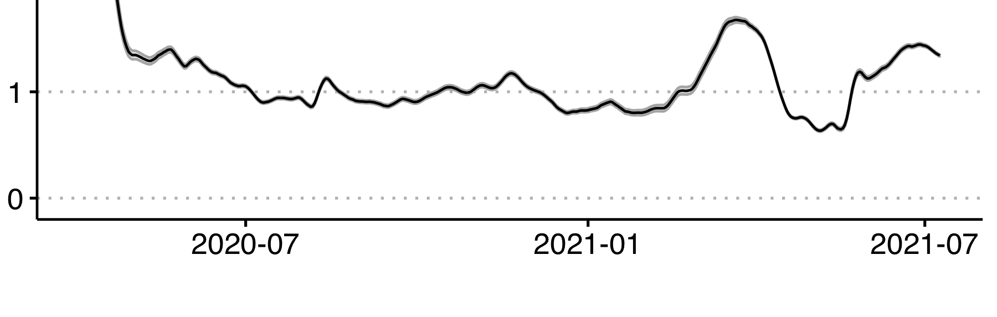
Each variant has been associated with different epidemiological characteristics
R very high before lockdown measures
R
Control measures kept R close to 1
R increasing under Delta
R surged with arrival of Beta
Beta - faster transmission
& more severe
Beta - faster transmission
& more severe
Delta - similar transmission & even more severe
Delta - similar transmission & even more severe
Original variant - slower transmission & less severe than later variants

Slide 7
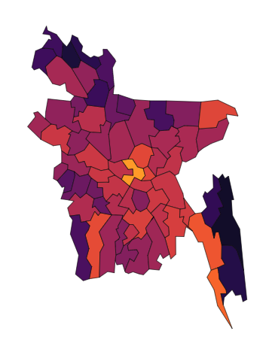
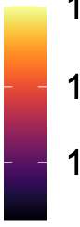
Delta began to emerge in Bangladesh months ago
29 April sequence in Rangpur from exposure in India
6 May sequence from community transmission in Rajshahi
28 April sequence in Barishal from exposure in India
The situation in May 2021 was dominated by cases in Dhaka in line with declining transmission of 2nd wave from Beta variant....
..But Delta had already been detected in several localities
Weekly cases per 100,000
100
10
1

Slide 8
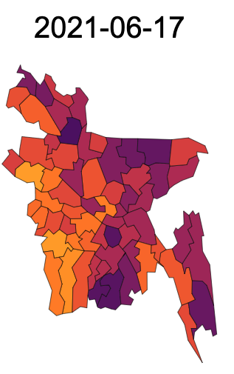
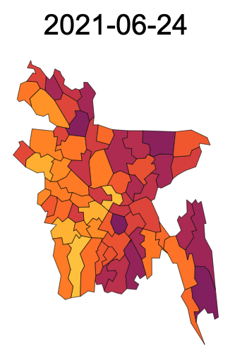
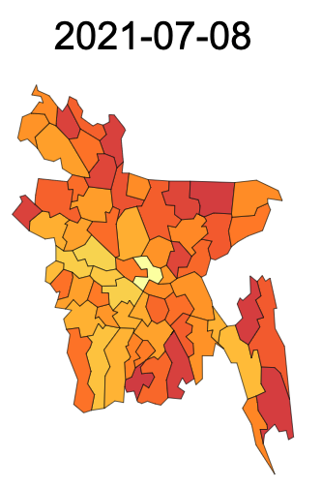
Resurgence has spread west-to-east from districts bordering India
Community transmission of Delta began in districts bordering India, but rapidly spread across the country
Mid-June Late June Early July
Weekly cases per 100,000
100
10
1

Slide 9
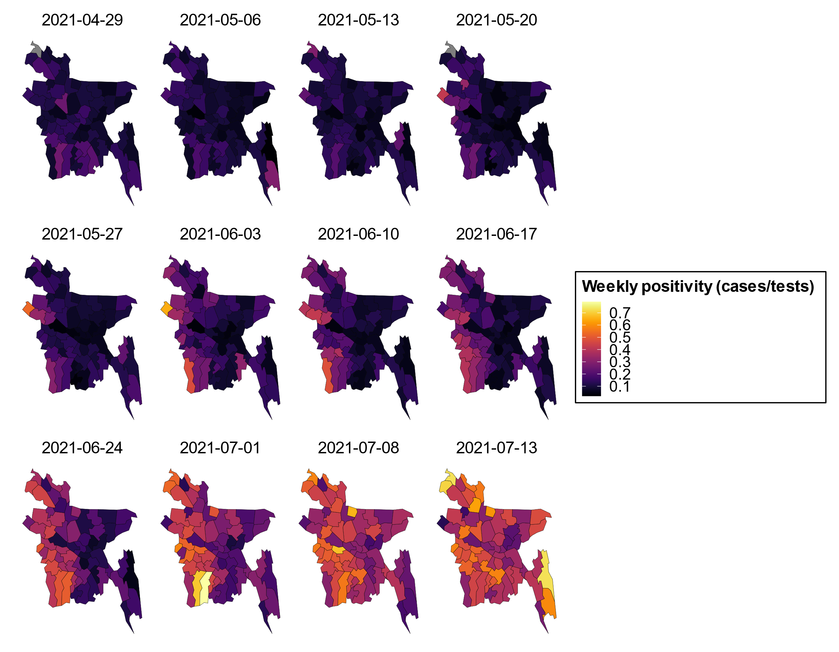
Resurgence has spread west-to-east from districts bordering India
Test positivity is dramatically skewed from West to East

Slide 10
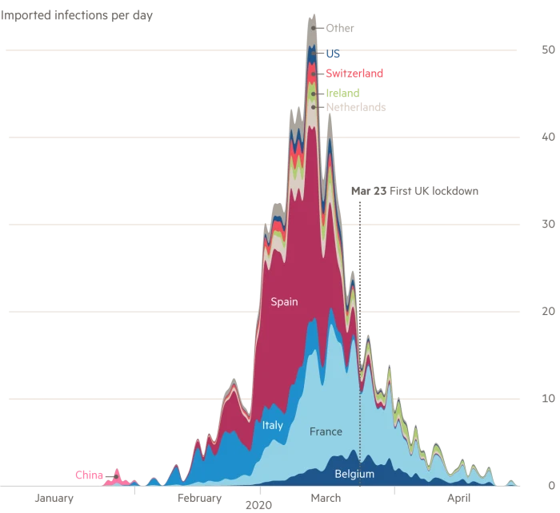
Importations seed new outbreaks that compound epidemic growth
This example from the first wave in the UK shows how importations from around the world led to an extremely large outbreak (because the UK was far too slow to lockdown)
The same process is occurring for the Delta variant in Dhaka (and other cities) as infections brought from other areas are seeding new outbreaks.
The early Delta sequences in April/May were the tip of the iceberg

Slide 11
The 3 stages of our response
Stage 1: Everything is fine
Stage 2: Oh that’s interesting, but doesn’t seem very severe
Stage 3: Oh sh*t, this looks worse than last time...lockdown!
visual: generic epidemic growth curve with both cases and deaths showing when get go through each of the phases and how much deaths lag behind cases

Slide 12
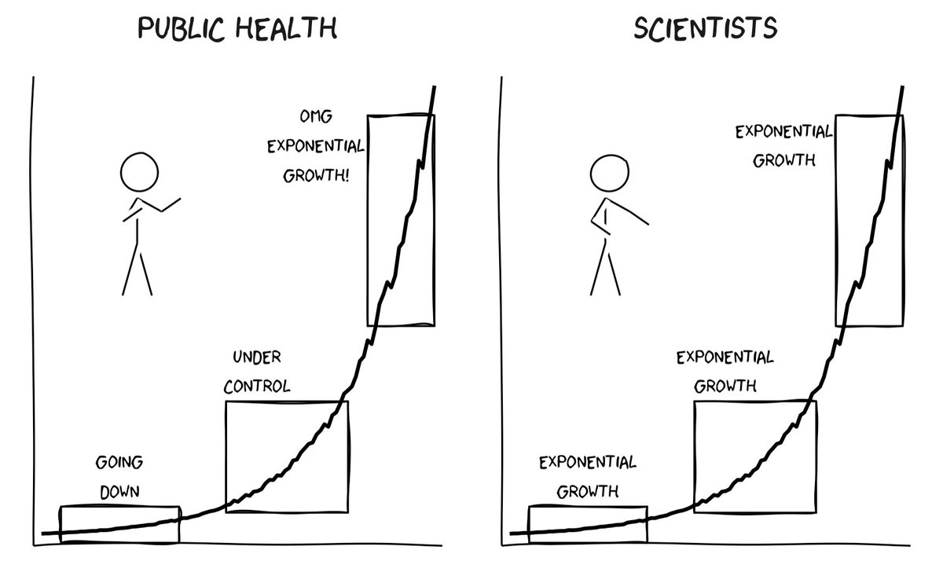
The 3 stages of our response
What happened:
What should have happened
(and still needs to):

Slide 13
The 3 stages of our response
What happened:
What should have happened
(and still needs to):
Lockdown but too late
Reinforce interventions
Still no action
Lockdown
Mask distribution & promotion
Vaccine rollout
No action

Slide 14
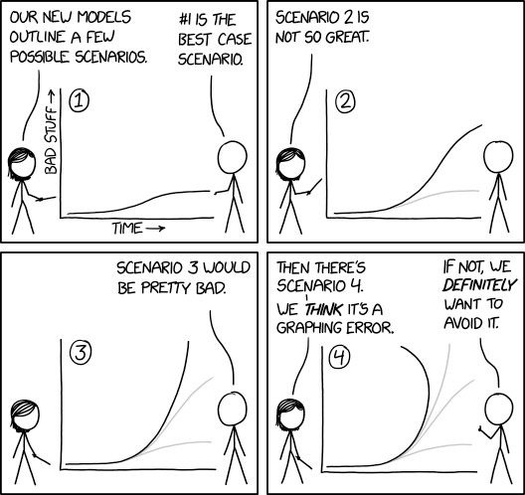
Depending on your sense of humour/ dread...

Slide 15
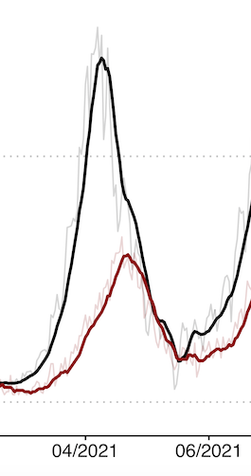
Deaths from Covid-19 always lag cases of infection by 3-4 weeks
Peak cases
Peak deaths
Cases and deaths from the April 2021 resurgence in Bangladesh due to the Beta variant
We should expect deaths to continue rising even as peak cases begin to declines
Hospital bed occupancy will take even longer to decline

Slide 16
How much longer will it go on for and how bad will it get?
Delta variant actually appears to be moving slower than the Beta variant, but likely with higher severity
Rashaji and Khulna have been at full bed capacity for 6-7 weeks → reasonable to assume the same will occur in Dhaka
Dhaka hospitals also likely to deal with more cases due to rural areas being hit first and sending cases followed by extended surge in Dhaka itself
Data: R estimation, curves of Rajshahi and Khulna
Can we use the Dhaka model to give a very rough/simple depiction of how long the surge could last in Dhaka at a lower R compared to the Beta variant?

Slide 17
When will this get better?
How long will it go on on for? And how much worse will it get?
Delta transmission rate faster than original variant (similar or less than Beta)
R very high before lockdown measures
R
Control measures kept R close to 1
R increasing under Delta
R surged with arrival of Beta

Slide 18
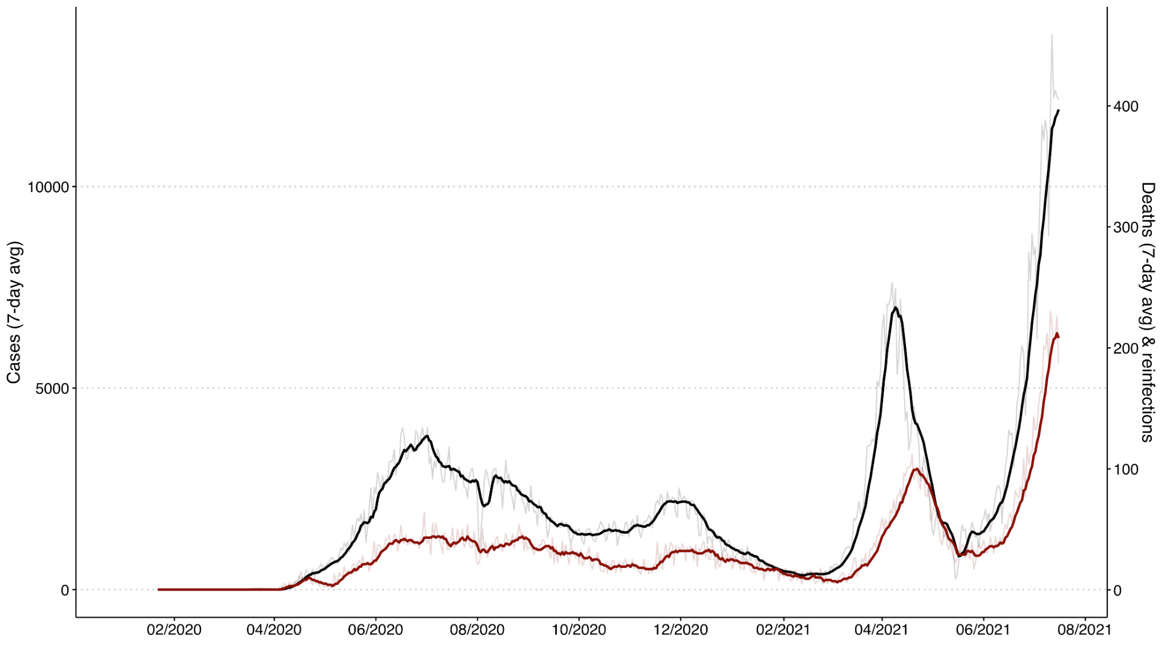
When will this get better?
How long will it go on on for? And how much worse will it get?
Delta transmission rate faster than original variant (similar or less than Beta)
Disease severity & case fatality higher
Increasing disease severity and case fatality
Original variant << Beta << Delta

Slide 19
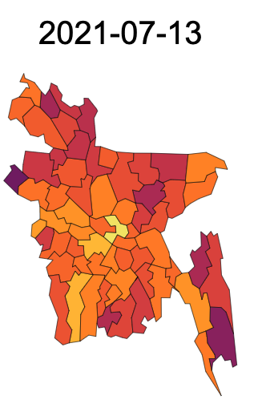
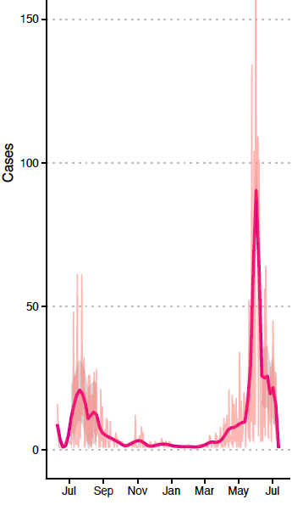
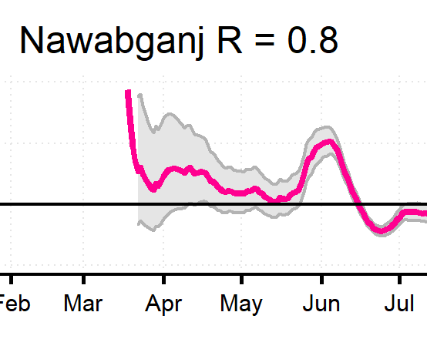
When will this get better?
How long will it go on on for? And how much worse will it get?
Cases in some of the first hit rural districts have already started to decline
Nawabganji

Slide 20
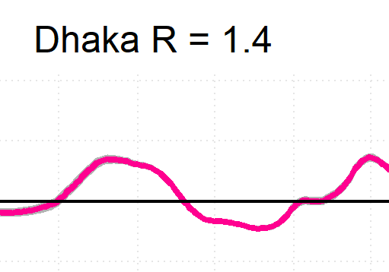
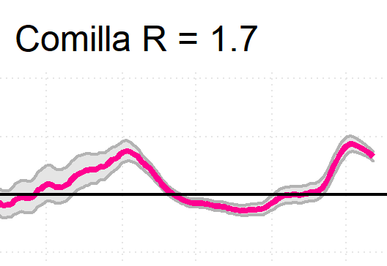
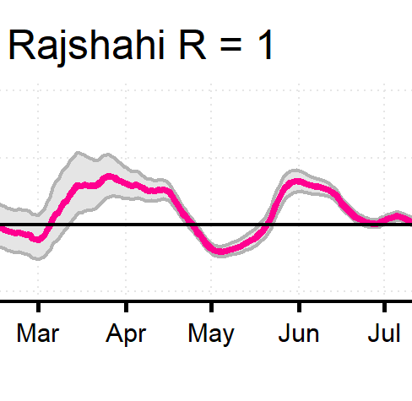
When will this get better?
How long will it go on on for? And how much worse will it get?
But R is greater than 1 in all but 3 districts, including Dhaka

Slide 21
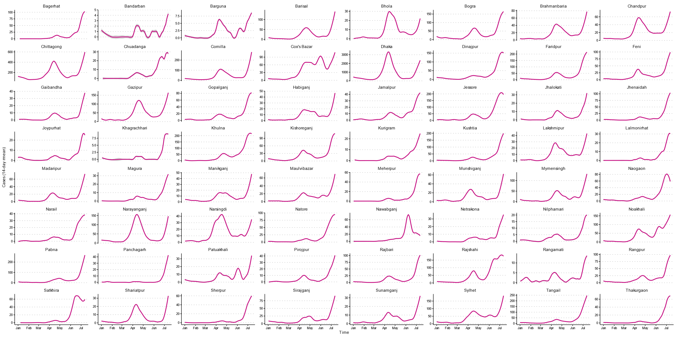
Cases are increasing rapidly in most districts

Slide 22
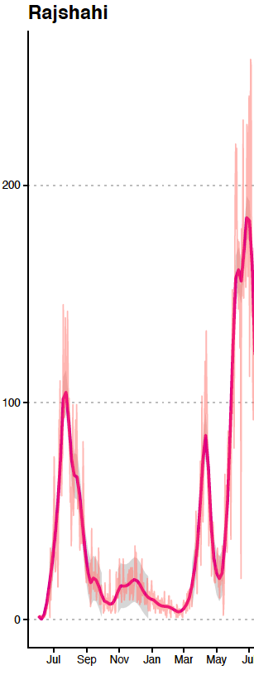
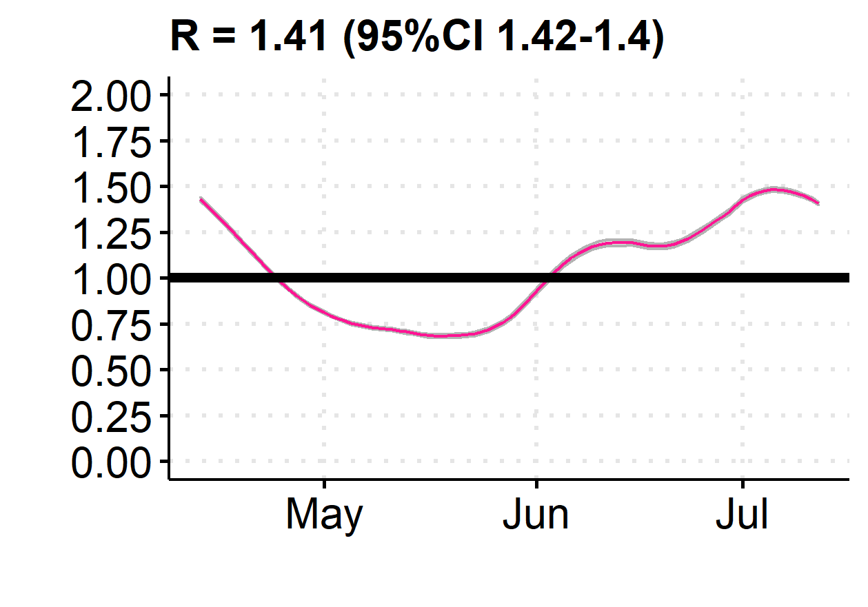
When will this get better?
How long will it go on on for? And how much worse will it get?
Urban areas will have more extended epidemics due to:
More imports seeding spread
Larger populations maintaining infection
Rural cases seeking care in urban health facilities
Outbreaks in the cities are longer lasting
Including Rajashi which was the first city to be hit
Dhaka is likely to be even more prolonged

Slide 23
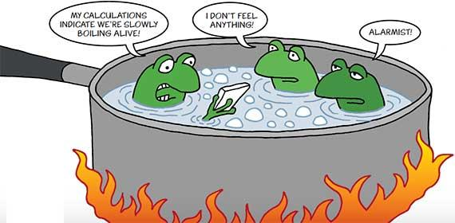
Taking a step back
Trajectory of the virus
Rapidly learning to evade our immune system
Becoming progressively more severe
Trajectory our response:

Slide 24
So what can we do differently?
It’s happened twice already, assume it will happen again
Lambda from Peru, Iota from USA, etc
If we keep waiting for cases and deaths to skyrocket to take action, we will always be too late
Continue to expand vaccination coverage as quickly as possible, focusing on most densely populated areas first to slow spread
Vaccination likely to continue to lag so mainstreaming masking, especially indoors and crowded areas is best option that is immediately available
Distribution of masks works. Promotion of mask-wearing works

Slide 25
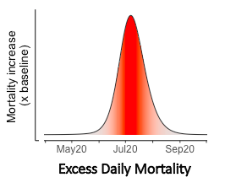
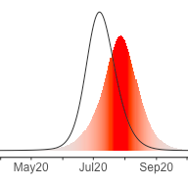
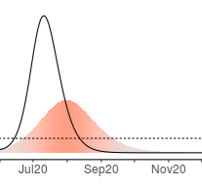
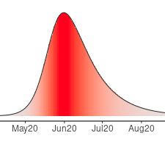
Lockdowns are very challenging and must be implemented early
Masks are practical and can still have impacts given the likely prolonged epidemic
Early lockdowns buy time
Only Masks
Late lockdowns have negligible impact

Slide 26
What needs to be done for the future?
Masks can STILL slow growth now - Mask messaging is CRUCIAL - outbreak will likely go on for months
Preparation for inevitable new variants.... Lambda
Need to take action now
Vaccine rollout
Build preparedness capacity & communications

